Slide 1
Intro to AI/Machine Learning
ChickTech High School Kickoff Event 12/3/22 and 12/4/22
Sandy Taylor
Julia Januchowski
Robert Taylor
Notes:
10 minutes
Introduction
Go around the room and introduce, name, school, why are you interested?

Slide 2
First Things First…
Survey
http://bit.ly/chicktech-presurvey
Email Account
Notes:
10:10-10:20

Slide 3
What is AI?
Notes:
10:20-11:00
What do you think AI is? Let’s brainstorm and write answers on the board. There are no wrong answers!
Some examples (Baymax from Big Hero 6, Robot vacuums, Amazon Alexa, Netflix recommendation systems, Google autocomplete, Face recognition, Microsoft Cortana)
Obviously not AI: i.e. automatic doors, word processing, motion sensor controlled lights
Questionable/grey area: i.e. A “robot vacuum” like the early Roombas might just be programmed to complete a pattern. However, most current “robot vacuums” can now scan the room to plan a course and return to the charging station when they need to be charged.
I’ll call out an example and everyone go on the AI spectrum – I just want you to justify your answer!
https://www.youtube.com/watch?v=mJeNghZXtMo

Slide 4
Introduction - Activity
For each example called out:
If it is AI - GO LEFT
If it is NOT AI - GO RIGHT
If you’re unsure or think it’s a little of both - GO TO THE MIDDLE
Make sure you have a reason for your choice!
Feel free to change your position.
Notes:
Ask one learner on each side why they chose their side.
Allow learners to be swayed and move based on other learners’ examples.
After learners have re-shuffled, ask a learner on the side with the most learners “Why is/isn’t this AI?” Then, ask “So, is that part of the definition of what makes something AI?”
For example, “Why aren’t motion-activated doors an example of AI?” or “What would have to happen to make it AI?” “Because they always respond the same way to someone stepping near a sensor” “Ok, so is ‘ability to react differently to different cases’ an important part of AI?”
As you do this, keep a running list of the factors that people are using to decide if something is AI or not. You will use this list to create your definition of AI.
What do you think about the factors that were used to classify A.I.? What do you think is missing?
Call on a few learners to share their thoughts. Make changes the definition if necessary.

Slide 5
Introduction - Lots of Definitions!
“Intelligence” itself is hard to define
Howard Gardner’s Definition of Intelligence (Cognitive Science, which studies how people learn):
"The capacity to solve problems or to fashion products that are valued in one or more cultural settings" (Gardner & Hatch, 1989)
Oxford English Dictionary’s definition of Intelligence:
"The ability to acquire and apply knowledge and skills."
From AI4ALL – Open Learning Program
Notes:
Which definition feels more accurate?
Which makes you feel more intelligent?
Which is more like the definitions of AI?

Slide 6
Introduction - AI4ALL’s Defintion
A branch of computer science that allows computers to make predictions and decisions.
From AI4ALL – Open Learning Program
Notes:
Making predictions refers to the ability to analyze the most likely outcome based on pattern recognition. For example, AlphaGo (which plays the board game Go) anticipates the most likely move that the player will make.
Making decisions refers to the ability to complete specific tasks without a coded instruction. For example, AlphaGo chooses a move to make from many options.
There are different definitions of AI. This is the one that will be used for this course. It probably looks different than the definition that the class came up with earlier, and that is OK.

Slide 7
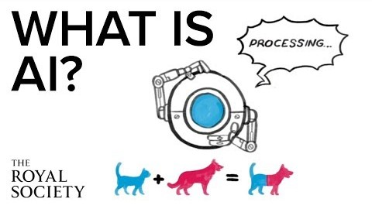
Introduction - AI Video

Slide 8
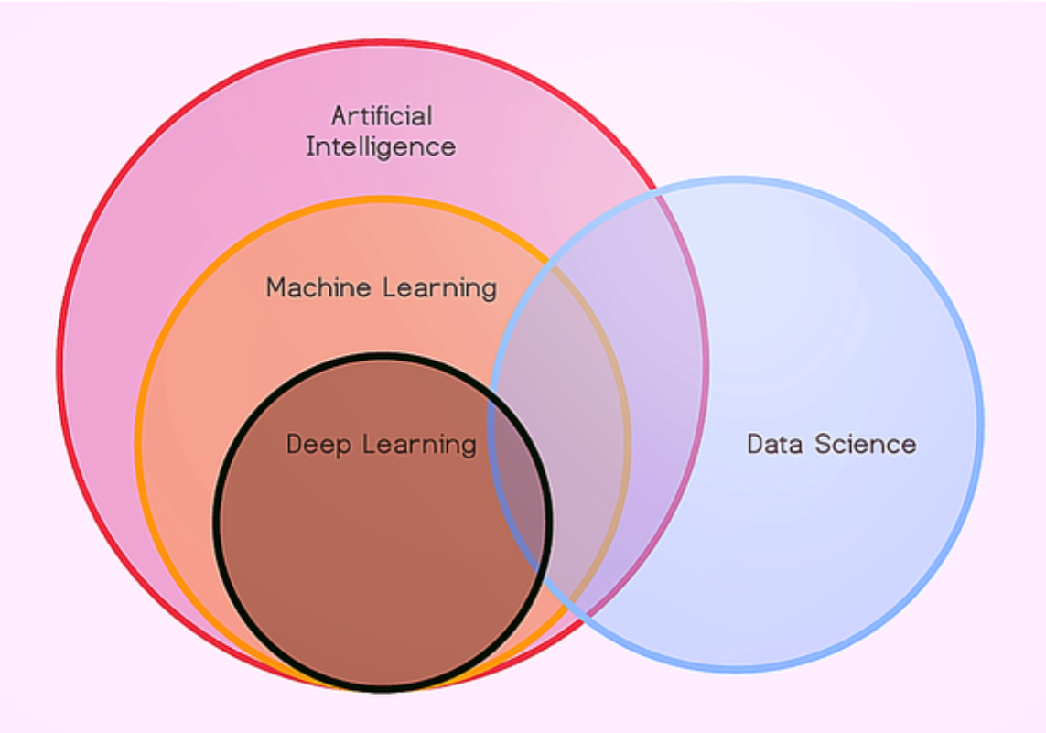
Machine Learning

Slide 9
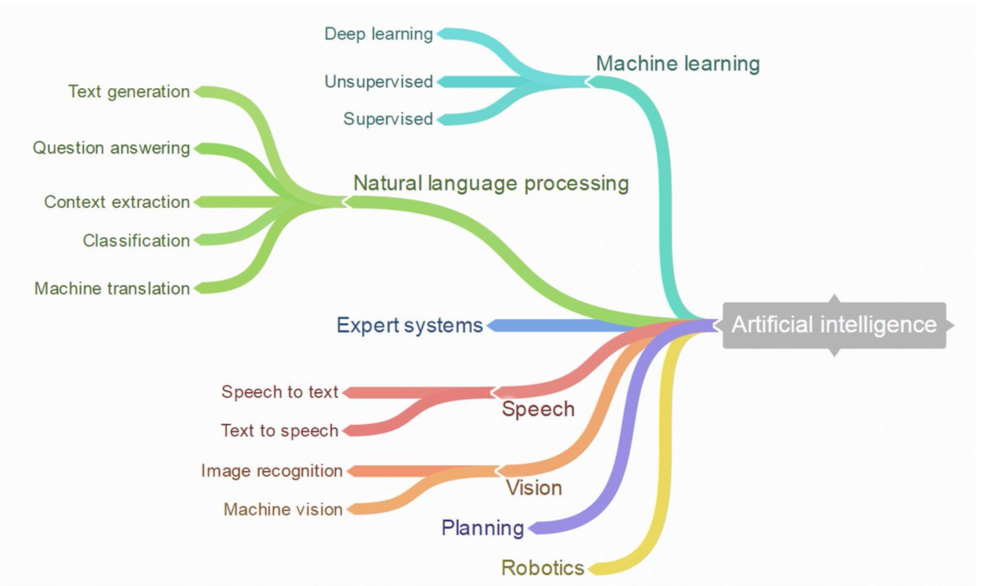
AI Fields
Image Source

Slide 10
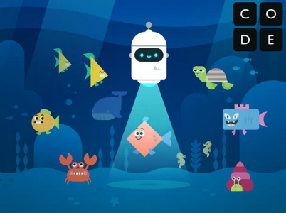
AI For Oceans Activity
Notes:
https://code.org/oceans

Slide 11
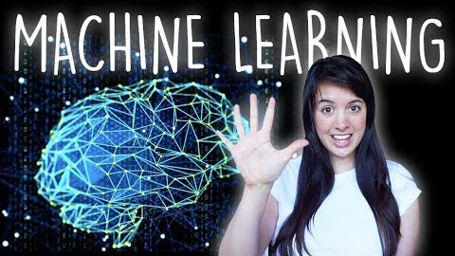
Machine Learning

Slide 12
Machine Learning - Terms
Algorithm: A sequence of instructions for accomplishing a task
Remember the definition of AI: A branch of Computer Science that allows computers to make predictions and decisions
Machine learning: An approach to teach computers how to make decisions based on data
Data: Information
From AI4ALL – Open Learning Program

Slide 13
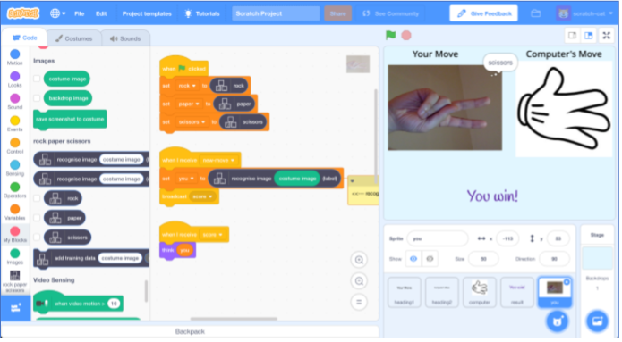
Machine Learning – Rock Paper Scissors
Machine Learning for Kids

Slide 14
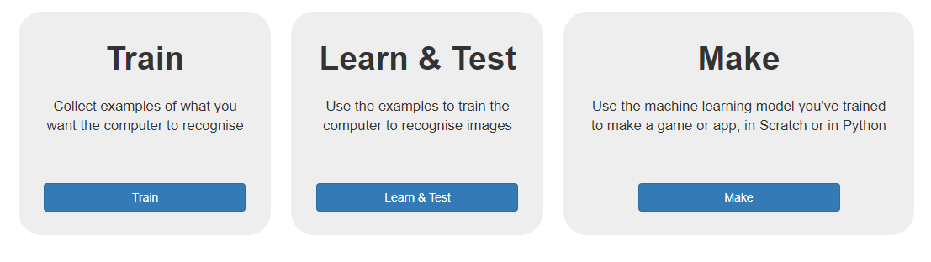
Machine Learning – Rock Paper Scissors
Machine Learning for Kids
Notes:
Follow the same process -

Slide 15
Machine Learning – Rock Paper Scissors
More examples! The more and varied examples you give it, the better the computer should get
Try and be even - Try and come up with roughly the same number of examples for each shape. Mix things up with your examples
Mix things up with your examples – small, far away, coming from different sides
Machine Learning for Kids
Notes:
If you have a lot of examples for one type, and not the other, the computer might learn that type is more likely, so you’ll affect the way that it learns to recognise photos.

Slide 16
Machine Learning – Rock Paper Scissors
https://machinelearningforkids.co.uk
Complete Steps 1-16 of the tutorial
Make sure to check out the tips section
Machine Learning for Kids

Slide 17
Machine Learning – Rock Paper Scissors
You’ve started to train a computer to recognize pictures as being rock, paper or scissors. You are doing it by collecting example photos. These examples are being used to train a machine learning “model”.
This is called “supervised learning” because of the way you are supervising the computer’s training.
The computer will learn from patterns in the colors and shapes from each of the photos you’ve given it. These will be used to be able to recognize new photos.
Machine Learning for Kids

Slide 18
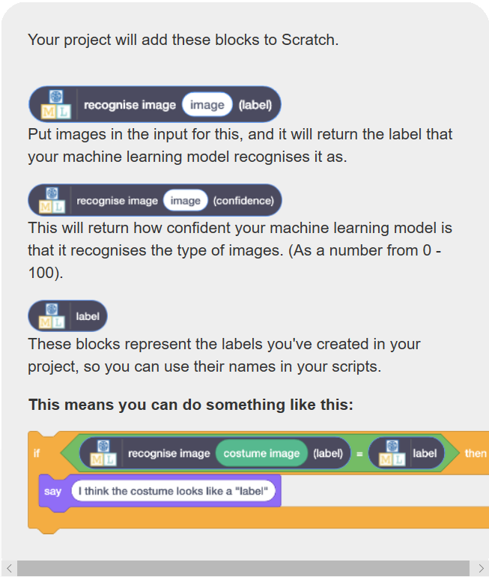
Machine Learning – Rock Paper Scissors
Teachable Machine With Google

Slide 19
Machine Learning – Rock Paper Scissors
You’ve made a simple rock-paper-scissors game in Scratch.
The game uses a webcam to take pictures of your hand, and uses machine learning to understand the meaning of the photo.
This is “image recognition” – teaching a computer to recognize images.
Machine Learning for Kids

Slide 20
Algorithmic Bias
Bias: (Oxford) prejudice in favor of or against one thing, person, or group compared with another, usually in a way considered to be unfair.
Algorithmic bias: Automated decision-making that reflects existing societal biases, often because the data that the decision was based on reflected those biases.
AI4ALL Open Learning

Slide 21
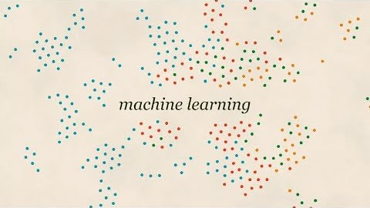
Algorithmic Bias
AI4ALL Open Learning

Slide 22
Algorithmic Bias
In machine learning, computers learn solutions by finding patterns in data.
Just because something is based on data, doesn’t automatically make it neutral.
AI4ALL Open Learning

Slide 23
Algorithmic Bias
Interaction bias: A computer trained on what a “shoe” looks like based on drawings by people
Latent bias: If you train a dataset to learn what a physicist looks like from old pictures of physicists, you wind up with a lot of white male faces (since those were the most recognized physicists of the past)
Selection bias: Make sure to select photos that represent all people
Google tries to stop bias by allowing users to flag inappropriate content.
AI4ALL Open Learning

Slide 24
Algorithmic Bias
Where does bias come from in Machine Learning algorithms?
Does bias have to be intentional?
Is bias bad?
AI4ALL Open Learning

Slide 25
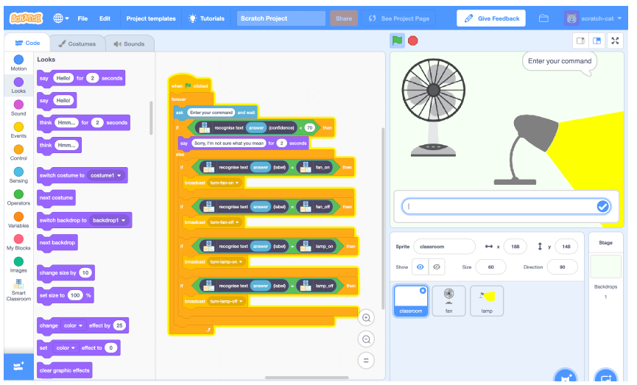
Smart Home Activity
Notes:
In this project you will make a virtual classroom that can react to what you say to it. You’ll be able to control the virtual devices in the classroom by saying what you want. To start with, you’ll program a list of rules for understanding commands, and learn why that approach isn’t very good. Next, you will teach the computer to recognise commands for different devices by giving it examples of each. This project worksheet is licensed under a Creative Commons Attribution Non-Commercial Share-Alike License http://creativecommons.org/licenses/by-nc-sa/4.0/

Slide 26
Smart Home Activity – Part 1
In this project you will make a virtual classroom that can react to what you say to it.
To start with, you’ll program a list of rules for understanding commands, and learn why that approach isn’t very good.
Next, you will teach the computer to recognize commands for different devices by giving it examples of each.

Slide 27
Smart Home Activity – Part 1
Complete Steps 1-17 of the tutorial:
Smart Classroom\worksheet-smartclassroom - Part 1.pdf

Slide 28
Smart Home Activity – Part 1
You’ve programmed the virtual classroom using a simple rules-base approach
Do you see any problems with this?

Slide 29
Smart Home Activity – Part 2
Complete rest of the tutorial:
\ChickTechAIWorkshopNCSU\Smart Classroom\worksheet-smartclassroom - Part 2.pdf
Make sure to read the reflection boxes (What have you done so far)

Slide 30
Smart Home Activity – Part 2
How is this better than our previous attempt?
What happened as you added more data?
What is a confidence score?

Slide 31
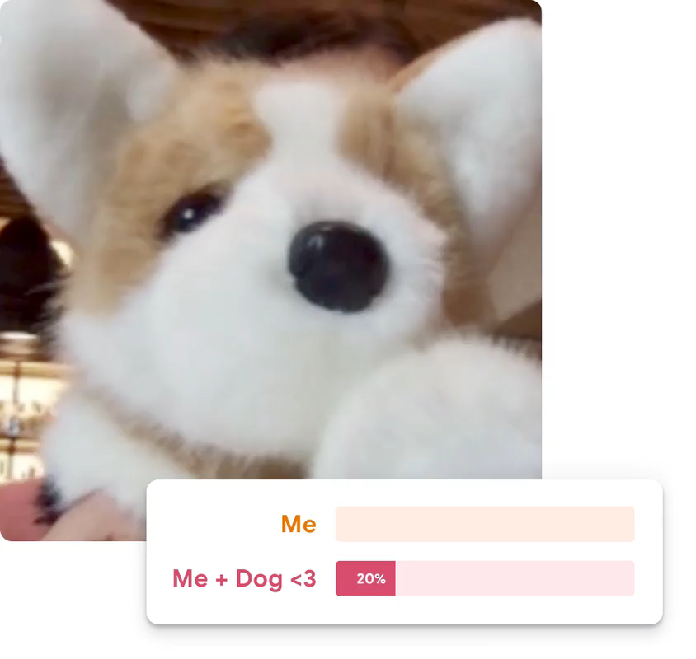
Machine Learning
Teachable Machine With Google

Slide 32
Machine Learning
https://bit.ly/2LvnvQe
Machine Learning for Kids

Slide 33
References
AI4ALL – Open Learning Program

Slide 34
Let’s Get Started! – Create your repo
What is a repository?
An online collection of your software work
Why do you need one?
A consistent place in the cloud to store your work
Accessible from anywhere
Keeps a living record of the changes you have made – version control

Slide 35
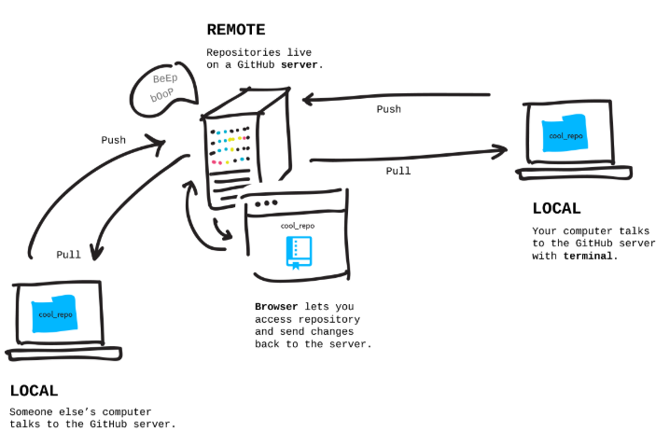
Let’s Get Started! – Create your repo
Image Source

Slide 36
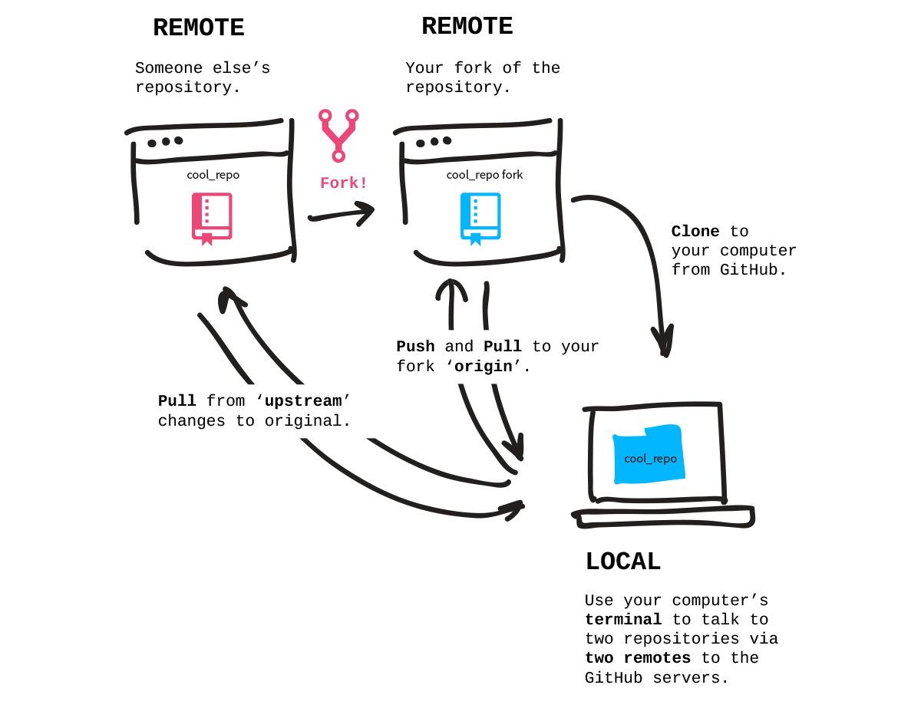
Let’s Get Started! – Create your repo
Image Source

Slide 37
Let’s Get Started! – Set up machine
https://github.com/staylornc/MovieRecommender

Slide 38
Let’s Get Started! – Review
We have created a GitHub account to store our work (repository)
We have configured a client to access that repo
We have forked my repo into your account as a starting point for your work

Slide 39
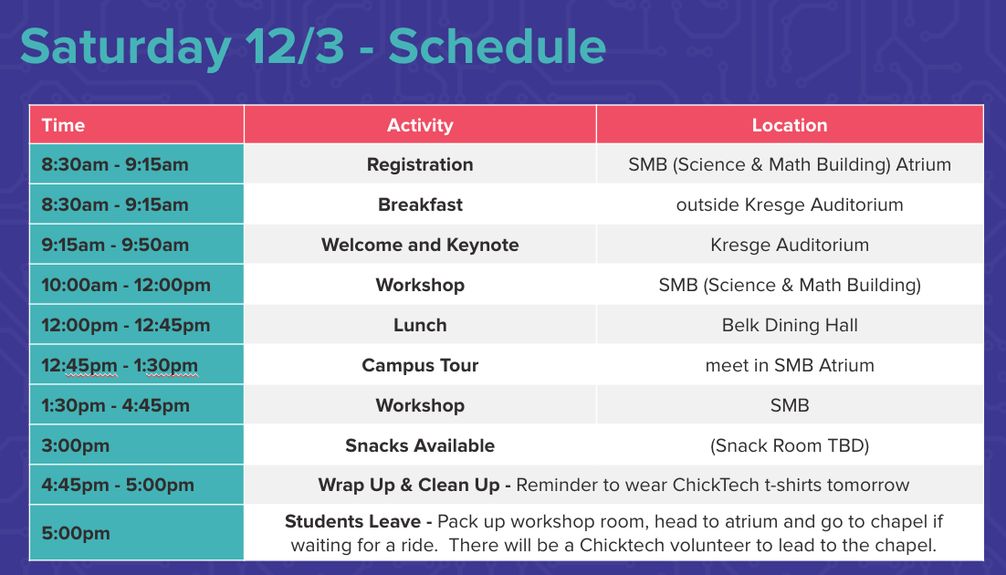
Notes:
Saturday
10 – introductions, ice breaker, AI intro
10:30 – AI for Oceans
11:30 – Teachable machines
1:30-2:30 – Rock, Paper, Scissors
2:30-3:00 – Review
3:30 – Google Experiments

Slide 40
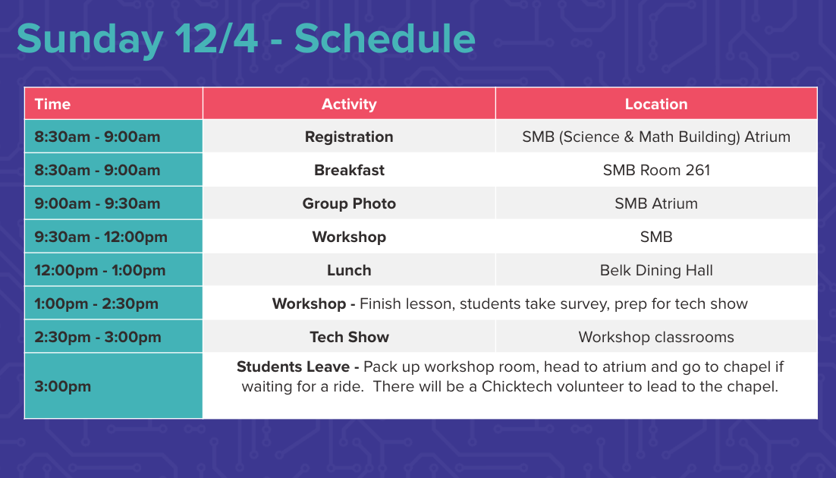
Notes:
9:30-10 – Review from yesterday
10-:11:20- DS intro /Movie Recommender
11:20-11:45 – review/lunch
1-1:30 – DallE – https://www.thispersondoesnotexist.com/
1:30-2:00 – movie recommender
2:00-2:30 – quick review, survey, prep for showcase

Slide 41
Movie Recommender

Slide 42
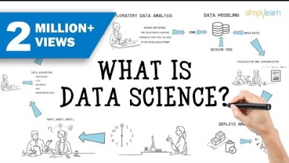
What is Data Science

Slide 43
Data Science
Data science is the process of cleaning, mining, and analyzing the data to derive insights of value from it. Extract data insights through a combination of exploratory data analysis and modeling. Data science is the process of distilling insights from data to inform decisions.
Data science creates models that capture the underlying patterns of complex systems and helps those models to become working applications.

Slide 44
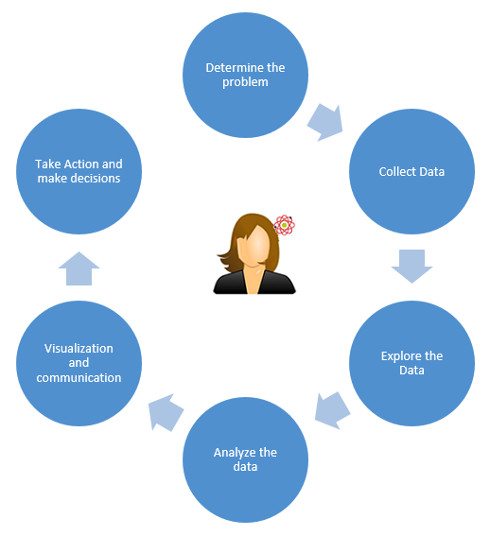
Data Science Process

Slide 45
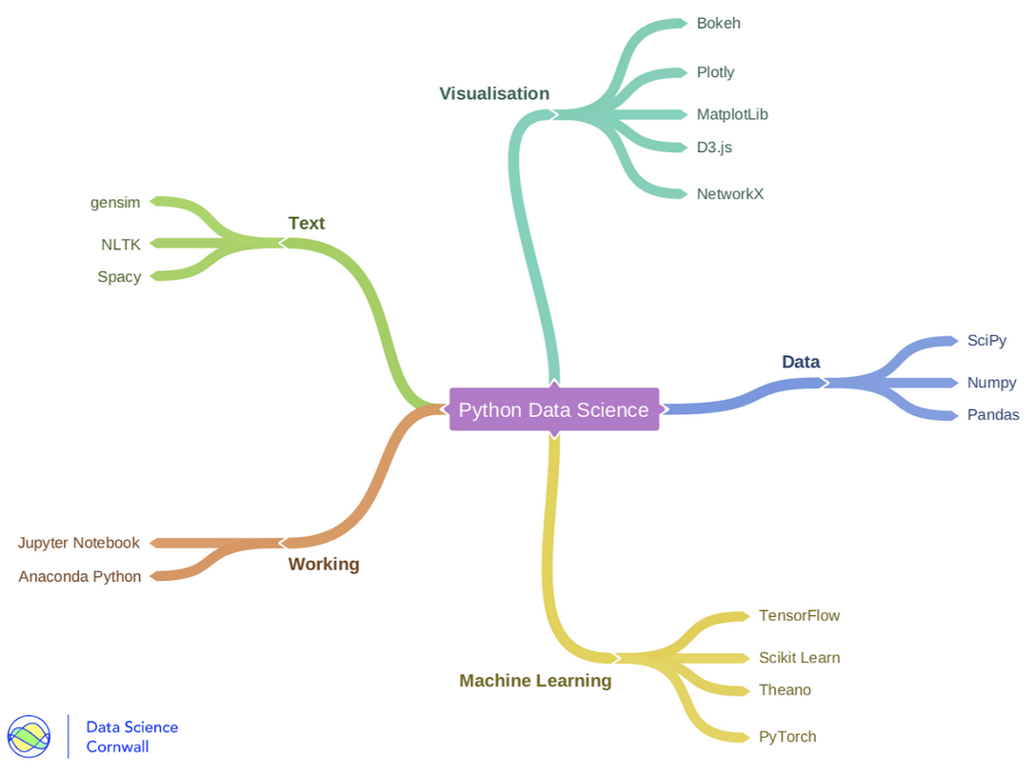
The Tools

Slide 46
Kaggle
Kaggle offers a no-setup, customizable, Jupyter Notebooks environment. Access GPUs at no cost to you and a huge repository of community published data
Crowd-sourced platform to attract, nurture, train and challenge data scientists from all around the world to solve data science, machine learning and predictive analytics problems
https://www.Kaggle.com/staylornc

Slide 47
After Lunch
Another Fun Application
Finish Movie Recommender
Take Survey https://bit.ly/chicktech-post-survey
Prepare for Tech Showcase

